Slide 1
Course Code:CSC402A Course Title: Web Architecture and Application Development
Course Leader:
Kishore S.M.
kishore.cs.et@msruas.ac.in

Slide 2
Objectives
At the end of the lecture, students will be able to
Describe structured oriented and object oriented software design

Slide 3
Contents
Structured vs object oriented software design
Entity-Relationship Diagram (ERD)
Data Flow Diagram (DFD)

Slide 4
Structured and Object Oriented Approaches to Software Design
 | Structured | Object-Oriented
Methodology | SDLC | Iterative/Incremental
Focus | Process | Objects
Risk | High | Low
Reuse | Low | High
Maturity | Mature and widespread | Emerging (1997)
Suitable for | Well-defined projects with stable user requirements | Risky large projects with changing user requirements

Slide 5
Structured and Object Oriented
Phase | Structured | Object-Oriented
Analysis | Structuring Requirements DFDs Structured English Decision Table / Tree ER Analysis | Requirement Engineering Use Case Model (find Uses Cases, Flow of Events, Activity Diagram) Oasadbject Model Find Classes & class relations Object Interaction: Sequence & collaboration Diagram, State Machine Diagram, Object to ER Mapping
Design | DB design (DB normalization) GUI Design (forms & reports) | Physical DB design Design elements Design system Architecture Design classes: Checking The Model, Combine Classes, Splitting Classes, Eliminate Classes Design components GUI design

Slide 6
Structured Analysis and Design
A. Analysis Phase
Determine system requirements
Structuring system process requirements
Logical requirements (logical modeling)
Structuring system data requirements
B. Design Phase
Database design (DB normalization)
Forms and report design (GUI design)

Slide 7
Structured Analysis and Design
A. Analysis Phase
Determine system requirements:
Interviewing: individuals and/or group
Structuring system process requirements
Entity-Relationship Diagram (ERD)
Data Flow Diagram (DFD) – logical process modeling
DFD levels (process decomposition)

Slide 8
Structured Analysis and Design
Entity-Relationship Diagram (ERD)
An entity relationship diagram (ERD) shows the relationships of entity sets stored in a database.
An entity in this context is a component of data. In other words, ER diagrams illustrate the logical structure of databases
ER diagram has three main constructs –
Entities
Attributes
Relations

Slide 9
Structured Analysis and Design
Entity
An entity is an object about which you want to store some information
Attributes
Attributes are the properties or characters of an entity
Student
USN
Student
Name

Slide 10
Structured Analysis and Design
Composite Attributes
An attribute which contains two or more other attributes is known as composite attribute
USN
Student
First name
Name
Last name

Slide 11
Structured Analysis and Design
Multivalued Attributes
Derived Attributes
USN
Student
Contact number
Birth Date
Student
Age

Slide 12
Structured Analysis and Design
Relationships
Relationship defines how two entities share information in a database
Binary Relationship and Cardinality
A relationship where two entities are participating is called a binary relationship.
Cardinality is the number of instance of an entity from a relation that can be associated with the relation.
One-to-one
One-to-many
Many-to-one
Many-to-many

Slide 13
Structured Analysis and Design
First name
duration
sub1
USN
Last Name
name
Subjects
sub2
1
takes
1
Student
Course
Sub Name
N
Birth Date
date
Contact number
Exam
Age
place

Slide 14
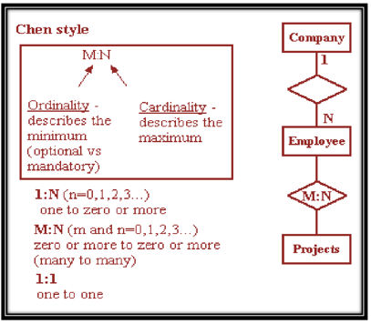
Structured Analysis and Design
ER Diagram Notations

Slide 15
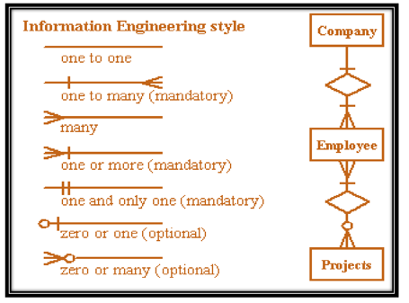
Structured Analysis and Design
ER Diagram Notations

Slide 16
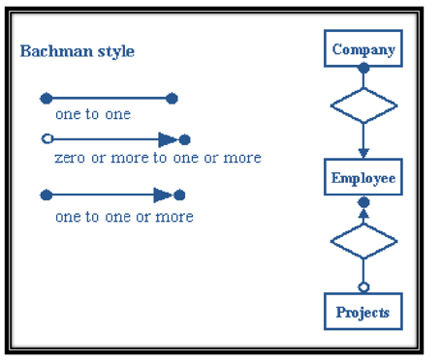
Structured Analysis and Design
ER Diagram Notations

Slide 17
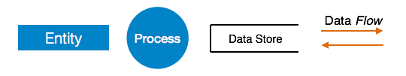
Structured Analysis and Design
Data Flow Diagram (DFD)
Data flow diagram is graphical representation of flow of data in an information system
It is capable of depicting incoming data flow, outgoing data flow and stored data
DFD Components

Slide 18
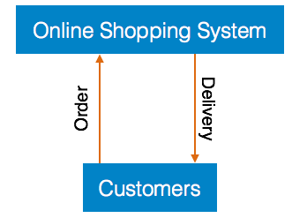
Structured Analysis and Design
Level 0 DFD or Context Diagram
Highest abstraction level DFD is known as Level 0 DFD, which depicts the entire information system as one diagram concealing all the underlying details

Slide 19
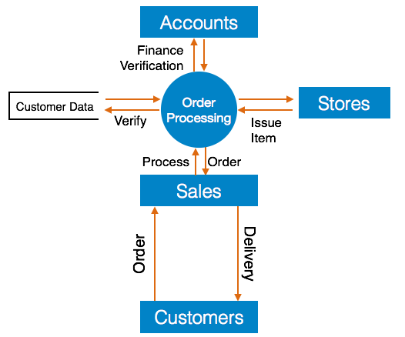
Structured Analysis and Design
Level 1 DFD
The Level 0 DFD is broken down into more specific, Level 1 DFD. Level 1 DFD depicts basic modules in the system and flow of data among various modules

Slide 20
Summary
An entity relationship diagram (ERD) shows the relationships of entity sets stored in a database
Data flow diagram is graphical representation of flow of data in an information system

